Slide 1
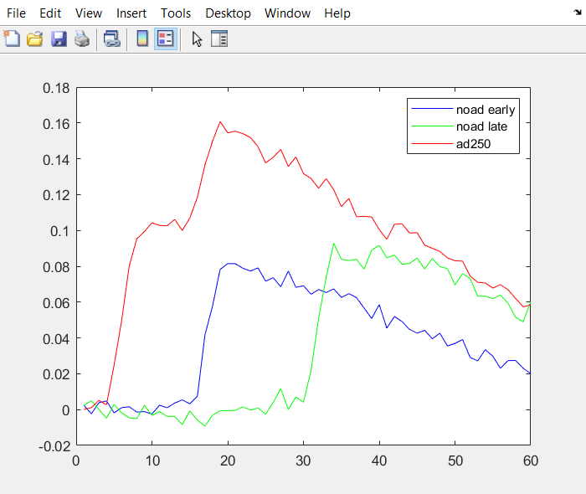
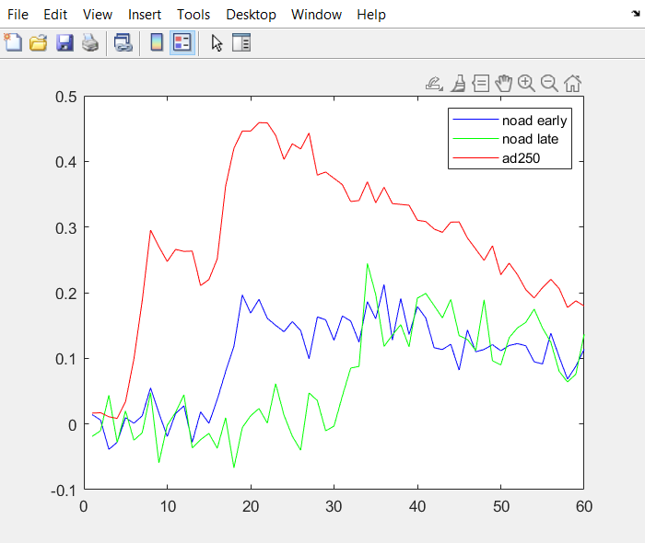
Timecourse of trials when stim2 ori = 90
Vis & ori-mod cells
Cell id = 1

Slide 2
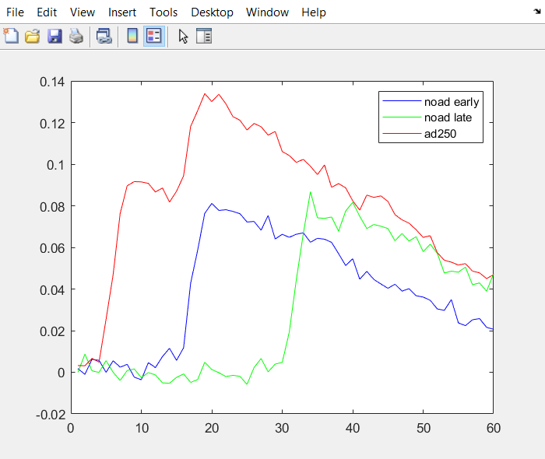
Timecourse of trials when stim2 ori = 90
Vis & ori-mod cells
Vis cells

Slide 3
New vis driven criteria
changed to: driven by any image (pass t-test to any stim2, but with bonferroni correction) AND amp threshold.
p_bonferroni_corrected = p_sig / nstim
Too few cells being classified as visually driven when p_sig = 0.05, had to raise p_sig acc. to Yuansi’s suggestion

Slide 4
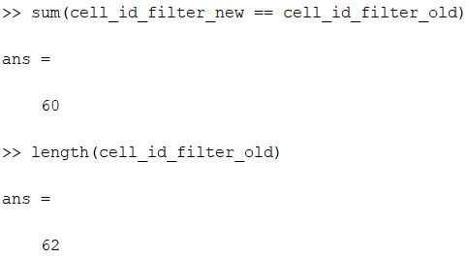
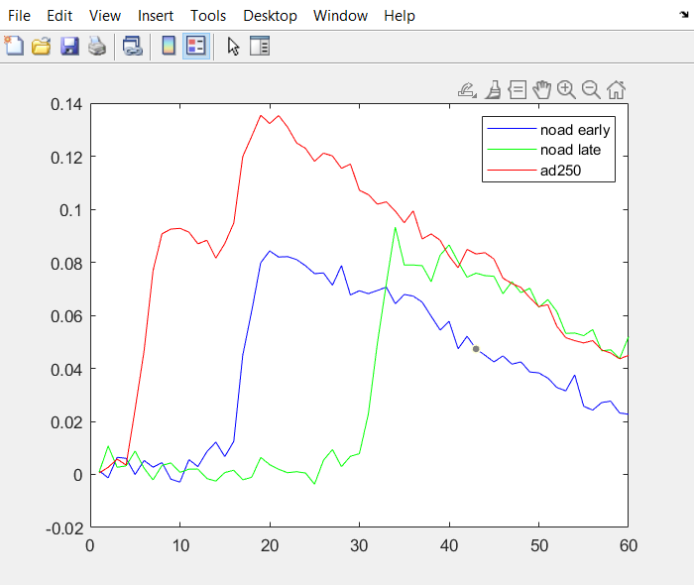
New vis driven criteria
New vis cells
(Old) vis cells

Slide 5
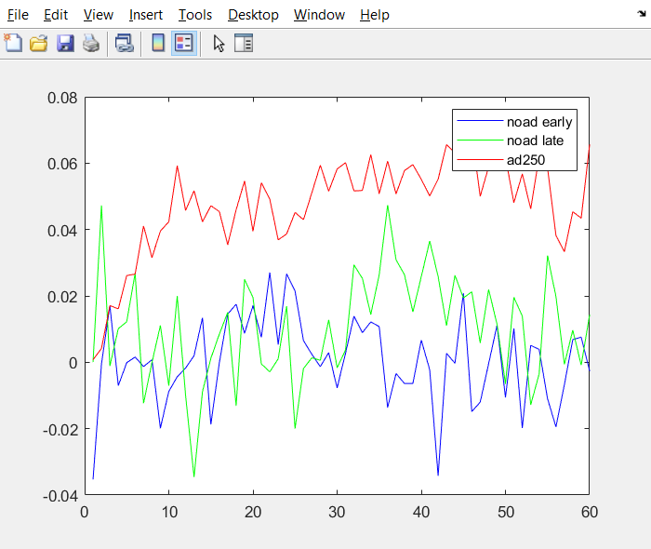
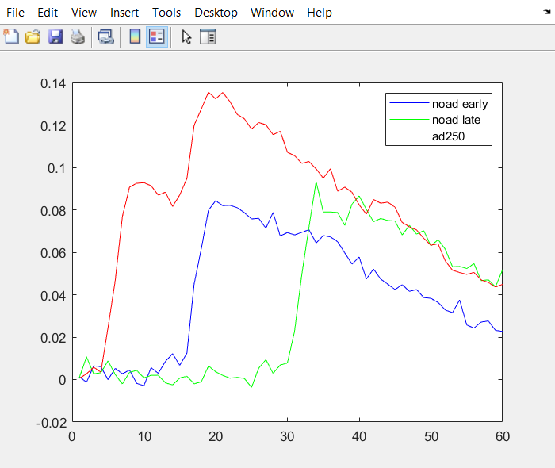
New vis driven criteria
Mean trace, new not-vis cells
Mean trace, new vis cells

Slide 6
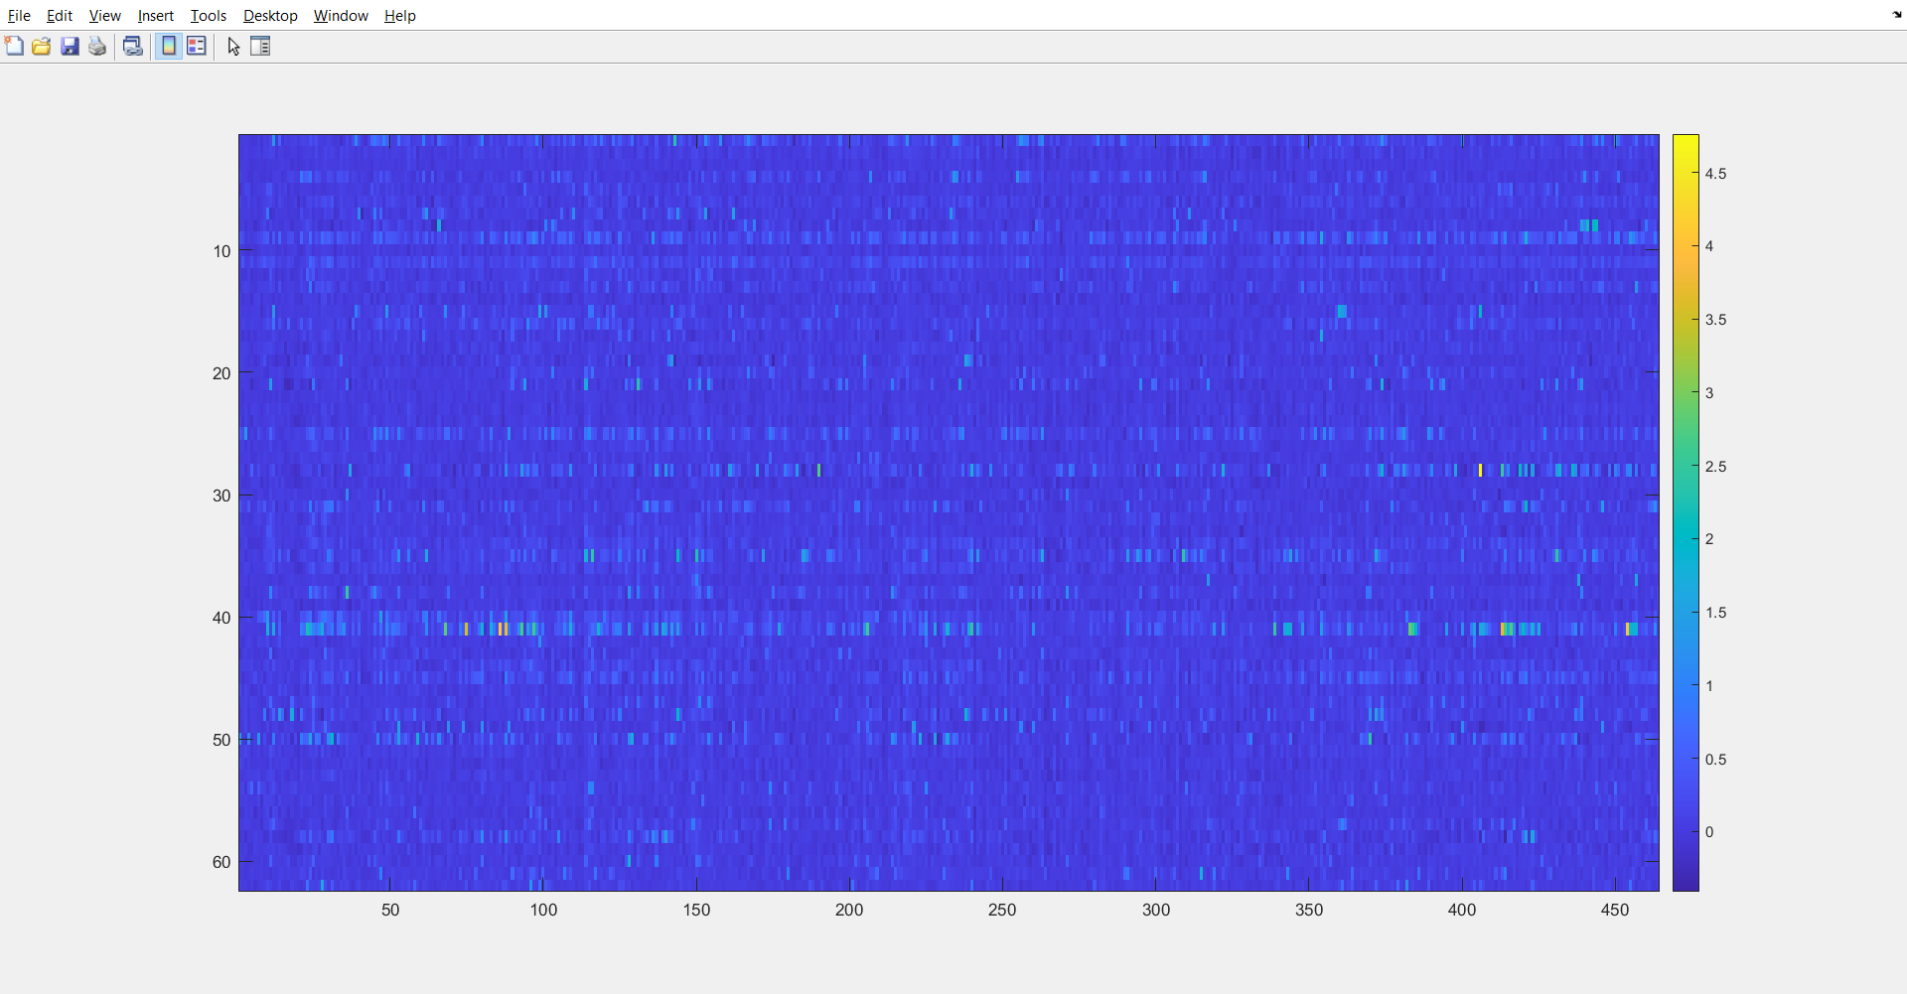
Outlier of response (ncell x ntrial) -> take median?

Slide 7
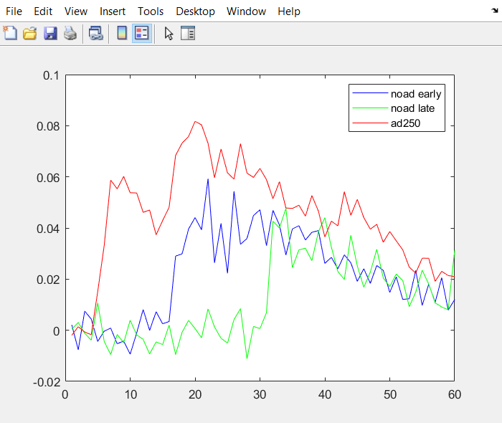
Median vs mean trace
Median trace, new vis cells
Mean trace, new vis cells

Slide 8
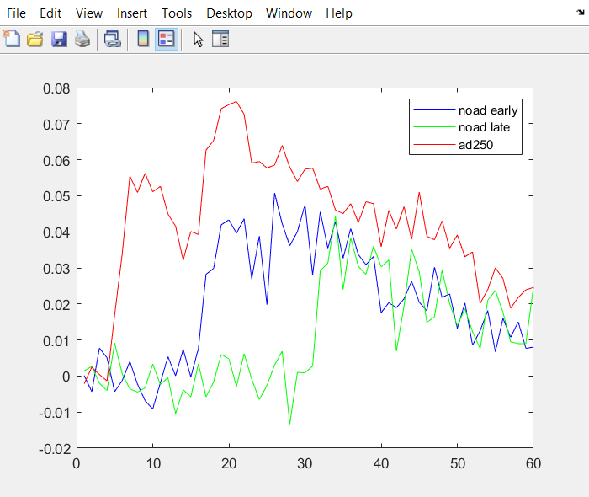
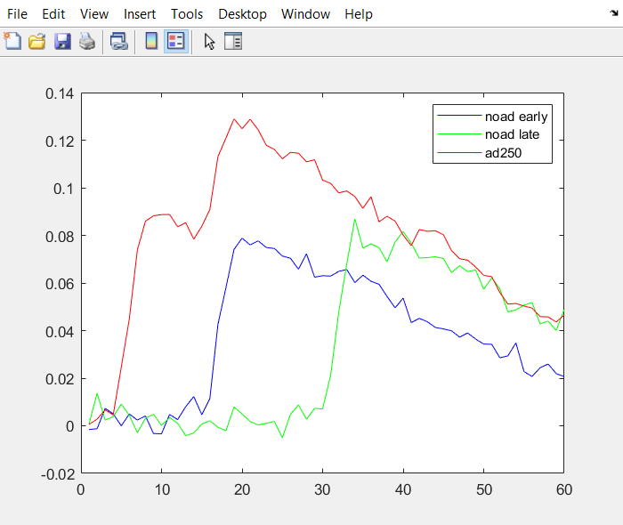
Median vs mean trace
Median trace, all cells (corrected)
Mean trace, all cells (corrected)

Slide 9
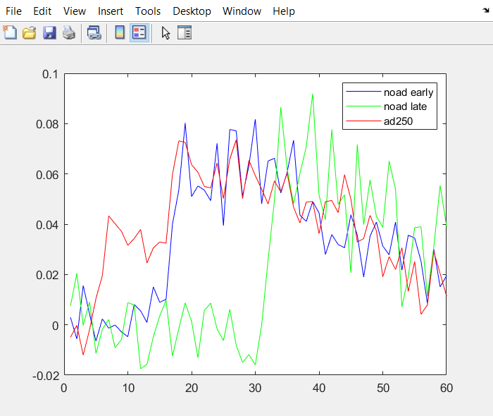
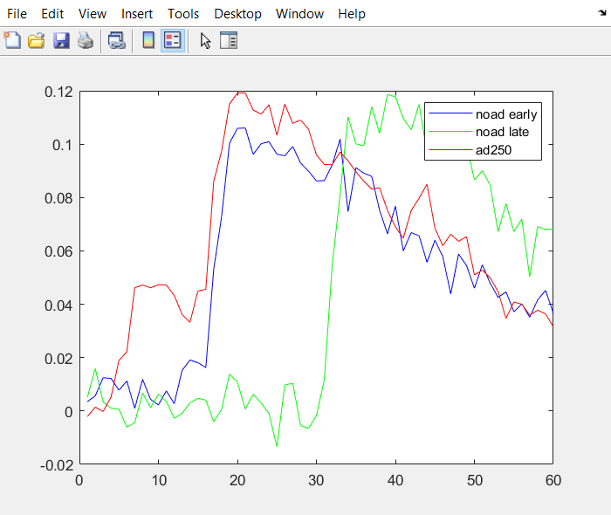
trials when stim2 ori = 90
Median trace, 90-deg preferring cells
Mean trace, 90-deg preferring cells

Slide 10
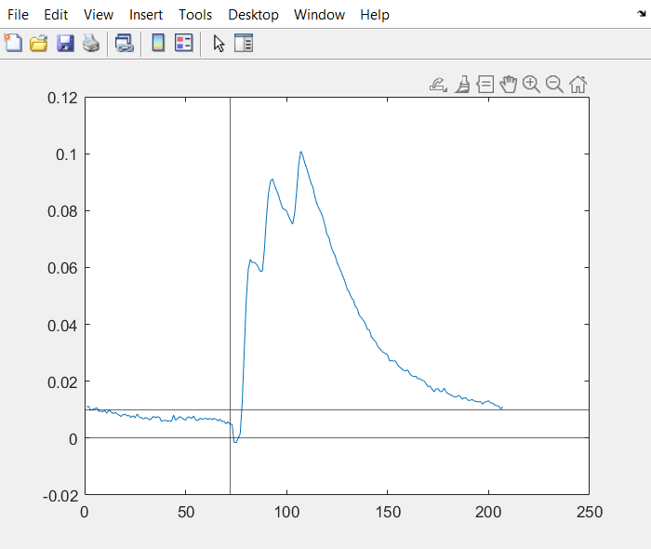
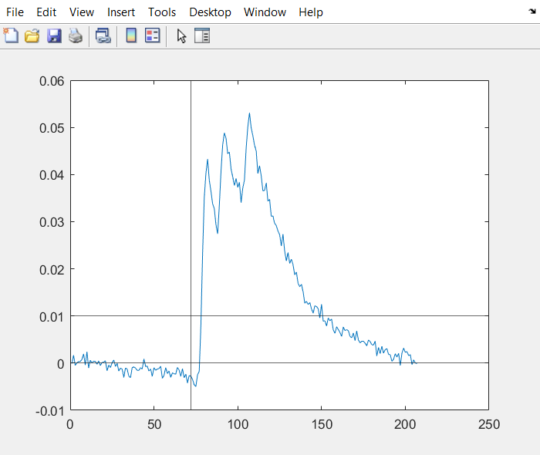
df/f baselining
Mean trace, ITI/2 first
Median trace, ITI/2 first

Slide 11
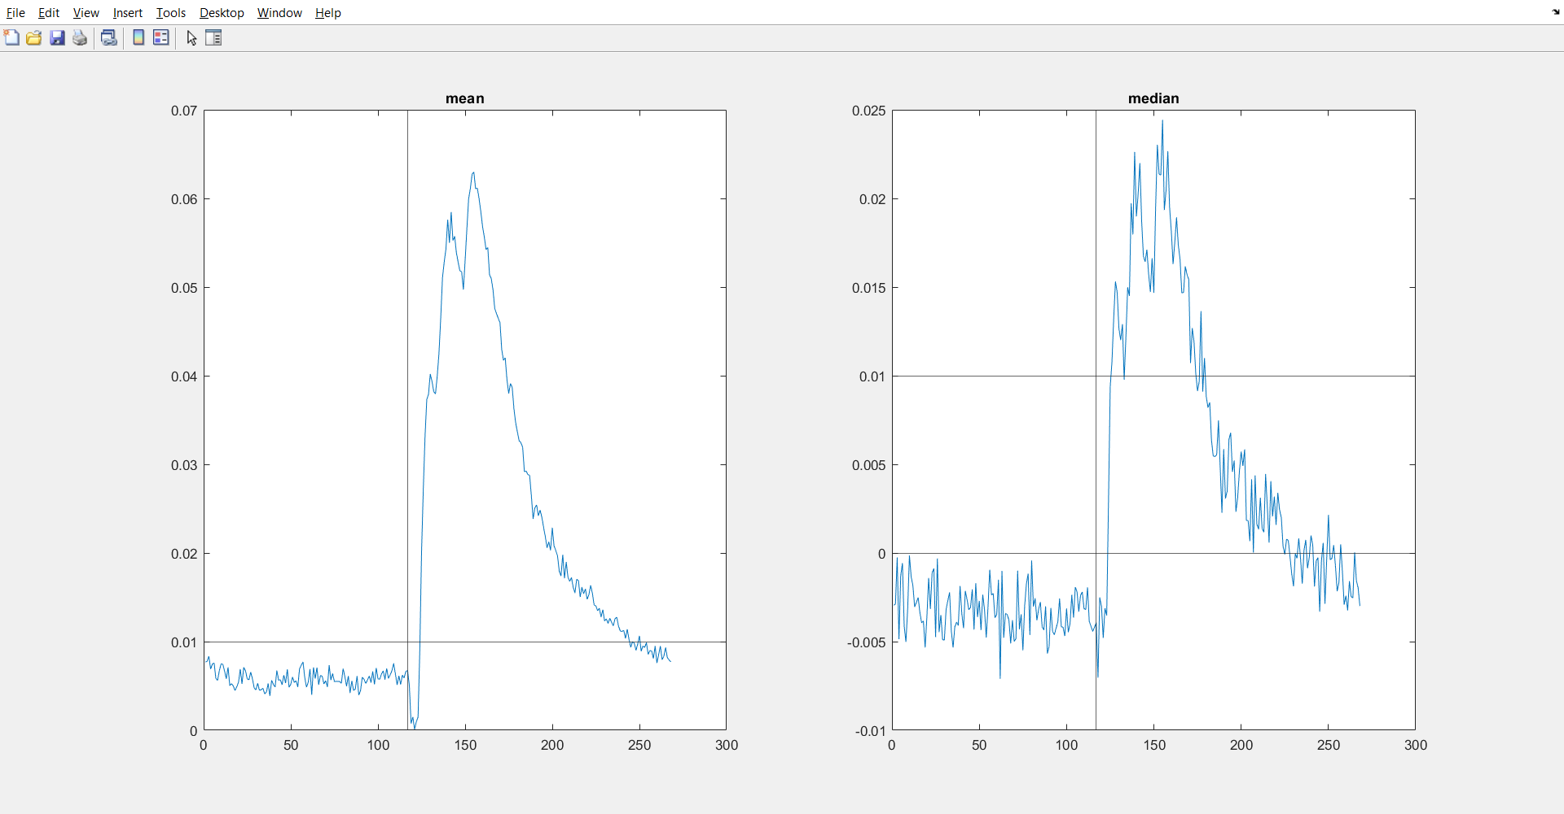
df/f baselining, data from miaomiao/lindsey align with stim 1 onset

Slide 12
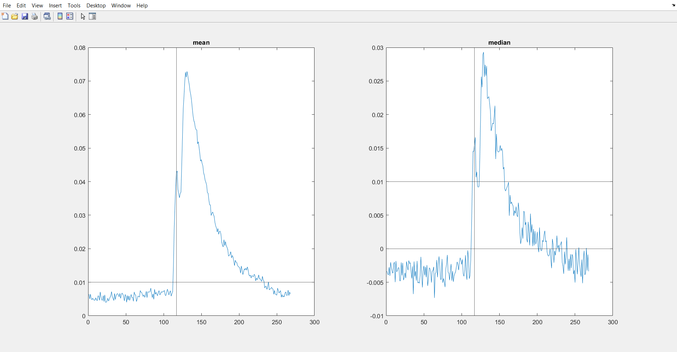
df/f baselining, data from miaomiao/lindsey align with stim 2 onset

